Slide 1

Human Automation Teams for Decision Making: Impact of Task load on Team Performance
April 8, 2025
CNI, IISc Bengaluru.
by
Kesav Ram Kaza
(Research fellow)
University of Ottawa

Slide 2


Agenda
Human Automation Teams
Human Factors?
Decision Referrals in Teams - Problem Formulation
Optimal Referral Strategy - Analysis and Simulation
Experimental Study
Application in Counter Drone Surveillance [briefly]
Framework
Experimental Study

Slide 3
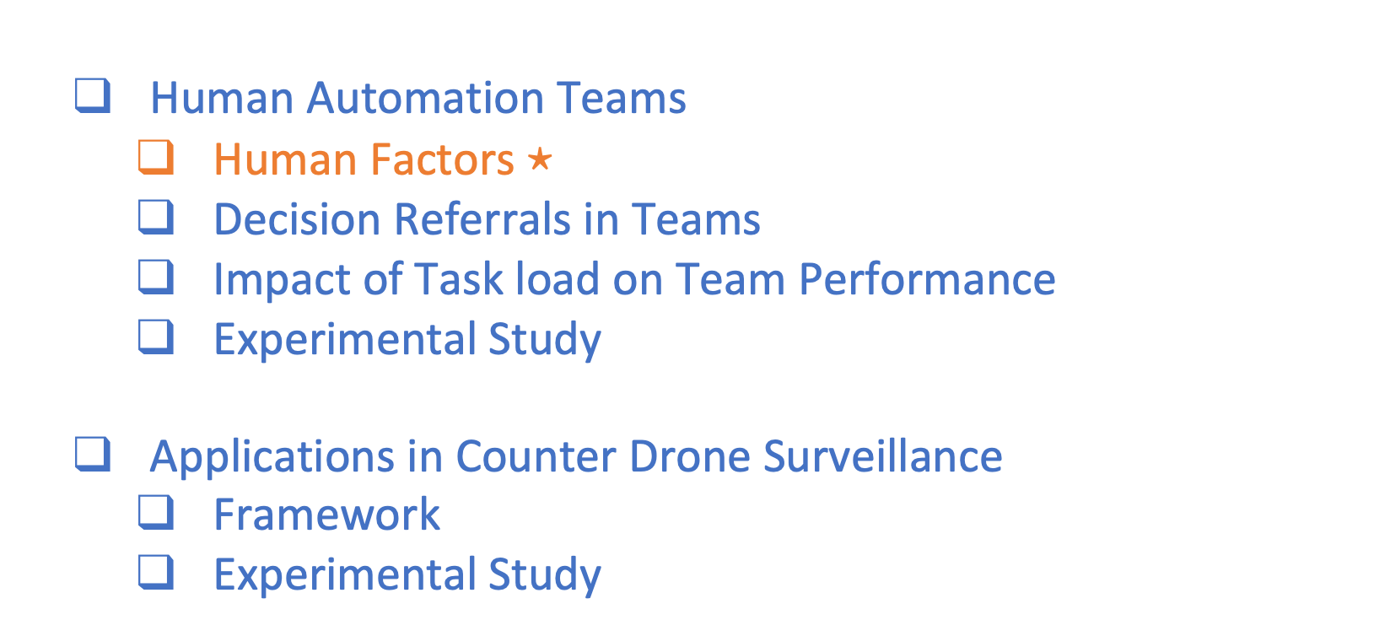
Agenda
Human Automation Teams
Human Factors $⋆$
Decision Referrals in Teams
Impact of Task load on Team Performance
Experimental Study
Applications in Counter Drone Surveillance
Framework
Experimental Study

Slide 4
Human Automation Teams
Background
Automation has come into the domains of both physical (manufacturing, assembly, etc) and mental tasks (data analysis and decision making)
Automation and humans have different models of decision making
Automation is good at number crunching
Humans are good at reasoning with quick mental models (??)
Humans are good at generalization (??)
In collaborative decision making both these strengths can be utilized.

Slide 5
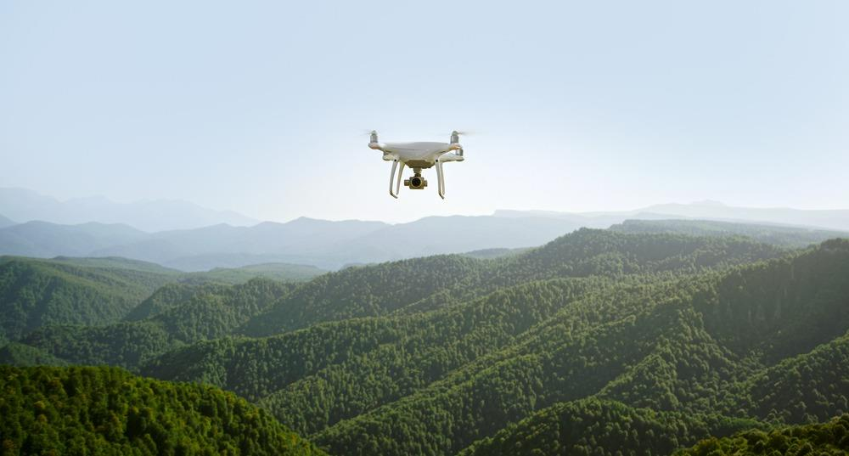
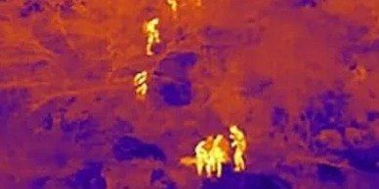
Human Automation Teams
Motivating Applications for Human-AI teaming
Search and Rescue Missions
Skimming through large amounts of data such as video footage, heat signatures, etc
Reconnaissance and intelligence for defence purposes
Identification of hostile targets
Automated mine detection
(Semi)-Autonomous navigation systems

Slide 6
Human Automation Teams
Decision Referrals in Human-Automation Teams
Setup
In Human-Automation Teams for decision making,
most task processing done by AI.
AI supervisor refers some to human for fresh analysis and final decision.
In a given set of tasks first processed by AI, how many and which tasks must be referred to the human?
Automation
Supervising
System
Human Reviewer

Slide 7
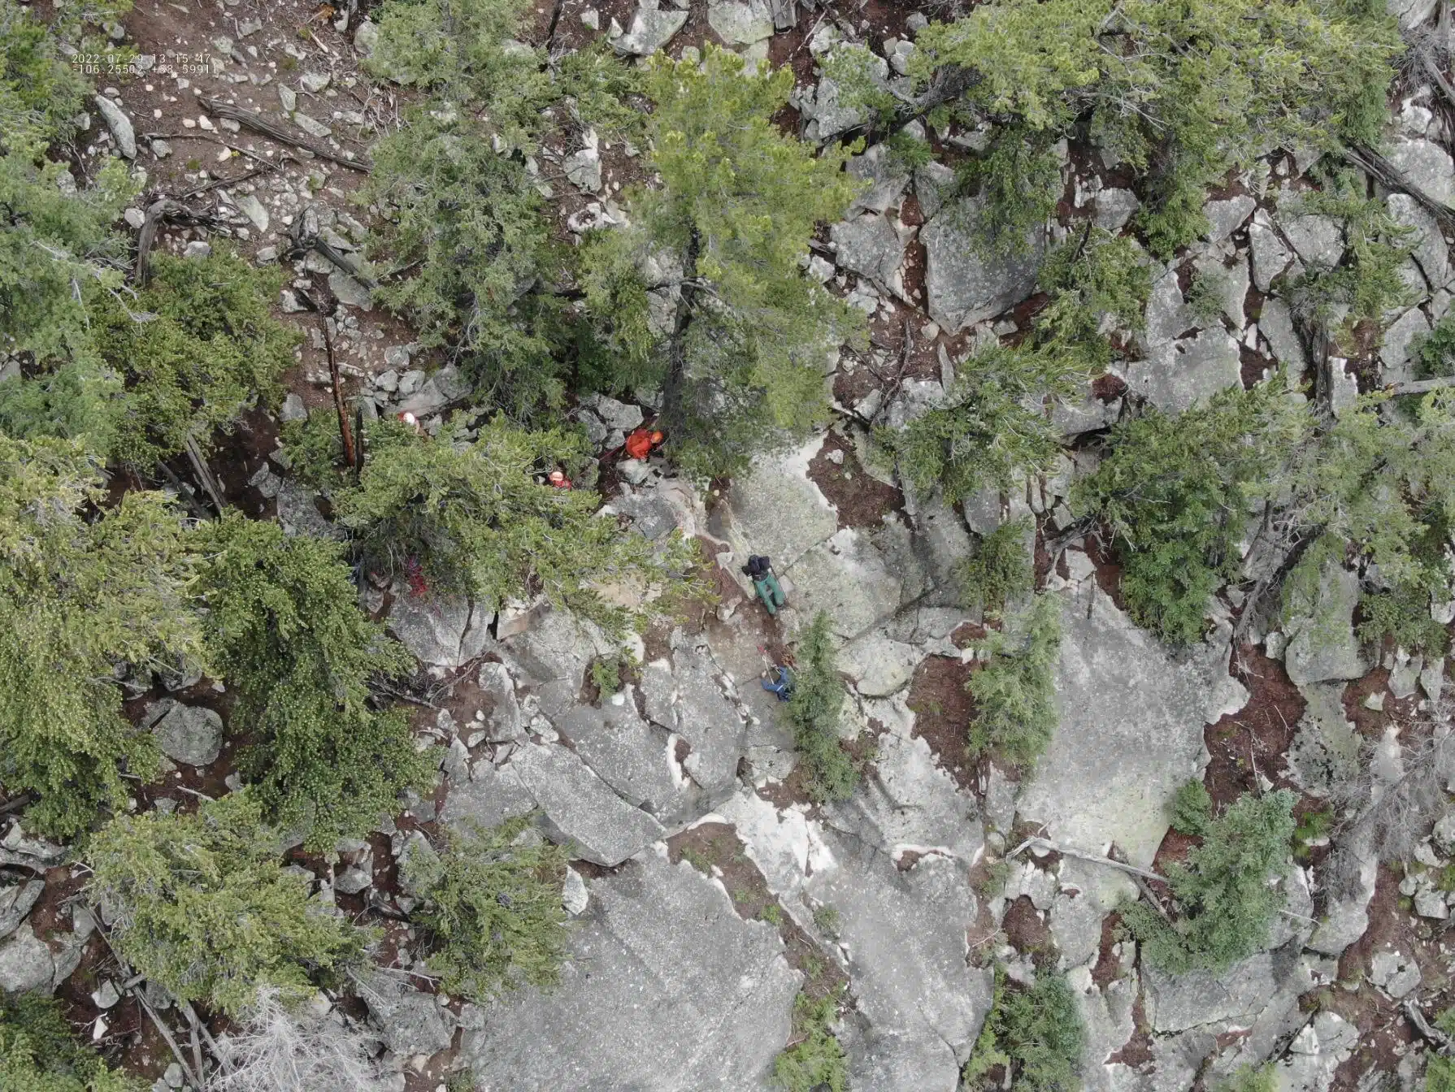
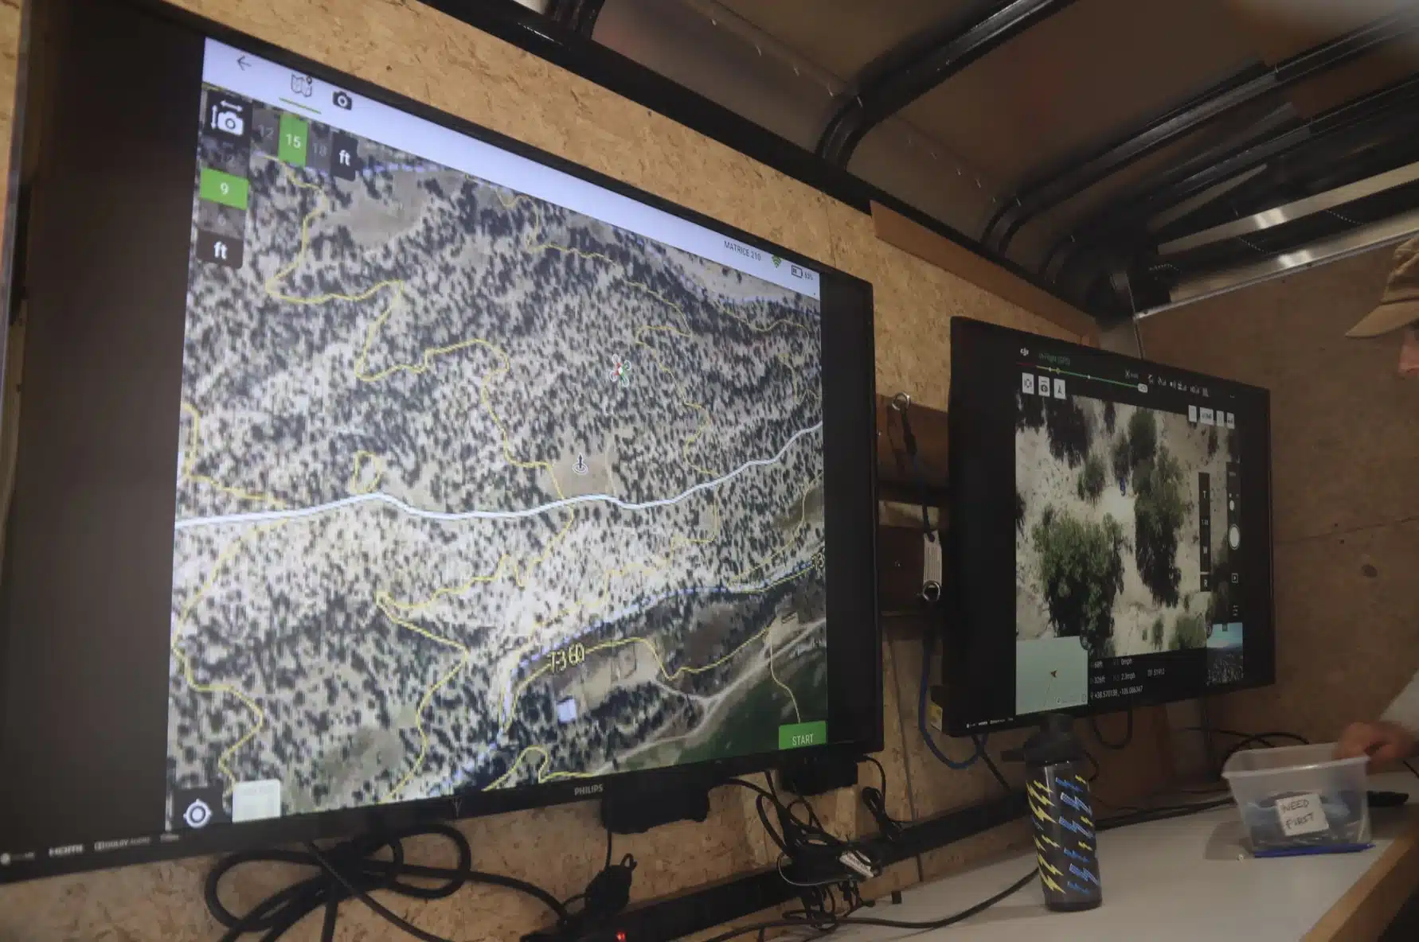
Human Factors
Human Factors affecting Performance
Physical and mental consequences for actions
Mental Workload
Fatigue
Belief, Trust in Automation
Self-Confidence

Slide 8
Human Factors
Human Factors affecting Performance
All these factors are complex cognitive constructs.
Hidden variables with multiple state definitions.
Lot of debate in psychology and human-factors literature.

Slide 9
Human Factors
Cognitive or Mental Workload in the Literature
The notion of mental workload is needed to answer questions of practical importance such as the following.
How busy is an operator?
How complex are the tasks that an operator needs to perform?
Can any additional tasks be handled by the operator?
Will the operator be able to respond to unexpected events?
C. D. Wickens, J. G. Hollands, S. Banbury, and R. Parasuraman,
Engineering psychology and human performance. Psychology Press,
2015.

Slide 10
Human Factors
Cognitive or Mental Workload in the Literature
Varied notions across literature
Definitions are based on models involving mental resources such as memory and attention.
“Low workload levels have been associated with boredom and decreased attention to task, whereas high workload levels have been associated with increased error rates and the narrowing of attention to the possible detriment of other information or tasks" [NASA-STD-3001 Technical Brief]
Measurement models
Self report measures
Physiological (or neurophysiological) measures
Primary task performance measures
Longo, Luca, et al. "Human mental workload: A survey and a novel inclusive definition."
Frontiers in psychology 13 (2022).

Slide 11
Human Factors
Cognitive or Mental Workload in the Literature
Varied notions across literature
Definitions are based on models involving mental resources such as memory and attention.
“Low workload levels have been associated with boredom and decreased attention to task, whereas high workload levels have been associated with increased error rates and the narrowing of attention to the possible detriment of other information or tasks" [NASA-STD-3001 Technical Brief]
Measurement models
Self report measures
Physiological (or neurophysiological) measures
Primary task performance measures
Longo, Luca, et al. "Human mental workload: A survey and a novel inclusive definition."
Frontiers in psychology 13 (2022).

Slide 12
Human Factors
Mental workload vs task load
Mental workload (MW) is a complex cognitive construct.
Task load - Defined as the number of tasks per session or fraction of tasks from a batch in a fixed period of time.
MW might be a non-linear function of task load along with other variables
MW is a system state that is not directly observable.
Can task load can be used as a handle on MW?

Slide 13
Human Factors
Mental Workload vs Task load
Under some conditions (?): can use task load as a descriptor of the mental workload.
This simplifies the model and avoids measurement problems.
Model the human as task load dependent performer.

Slide 14
Human Automation Teams
Task allocation planning problem classes
Human Side
Human as interventionist
may redo some tasks completed by automation.
may interrupt tasks of robot.
Human as non-interventionist
may or may not adhere to assigned task load.
Automation Side
Blind task allocation
focussed on optimal workload distribution, does not look at the tasks before allocation.
assigned based on estimated “mean” cognitive state or expected performance of the human.
Informed task allocation
looks at each and every task to decide.

Slide 15
Human Automation Teams
Task allocation planning problem classes
Human Side
Human as interventionist
may redo some tasks completed by automation.
may interrupt tasks of robot.
Human as non-interventionist
may or may not adhere to assigned task load.
Automation Side
Blind task allocation
does not look at the tasks before allocation.
assigned based on estimated “mean” cognitive state or expected performance of the human.
Informed task allocation
looks at each and every task to decide.

Slide 16
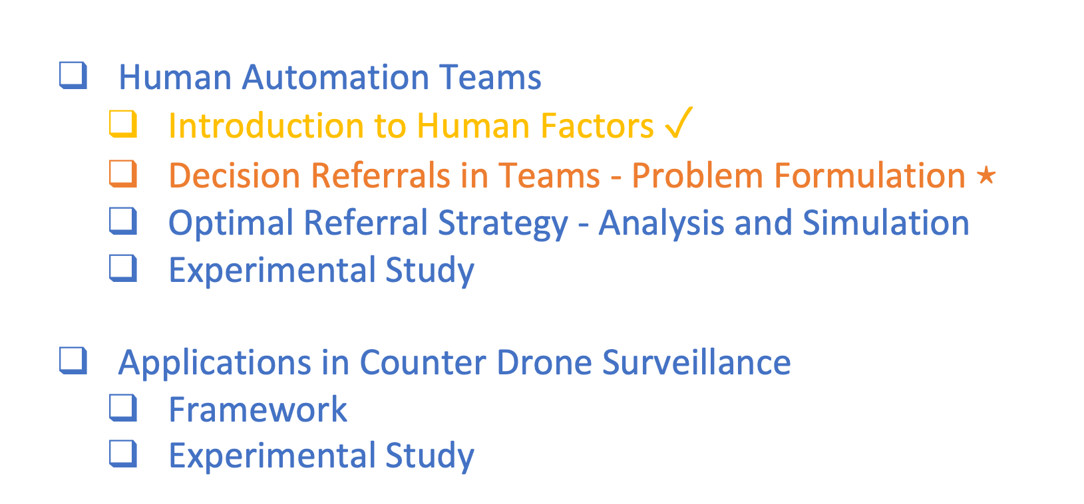
Agenda
Human Automation Teams
Introduction to Human Factors $✓$
Decision Referrals in Teams - Problem Formulation $⋆$
Optimal Referral Strategy - Analysis and Simulation
Experimental Study
Applications in Counter Drone Surveillance
Framework
Experimental Study

Slide 17

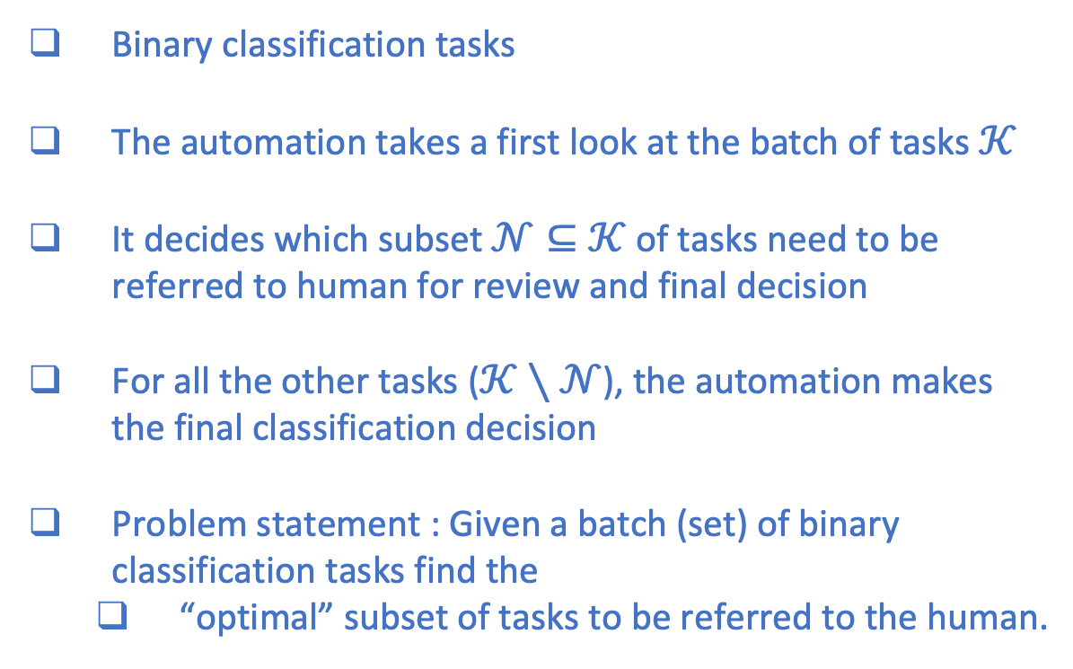




Human Automation Teams
Decision Referrals in Teams for Classification Tasks
Binary classification tasks
The automation takes a first look at the batch of tasks $𝒦$
It decides which subset $𝒩⊆𝒦$ of tasks need to be referred to human for review and final decision
For all the other tasks ($𝒦∖𝒩$), the automation makes the final classification decision
Problem statement : Given a batch (set) of binary classification tasks find the
“optimal” subset of tasks to be referred to the human.
Batch $𝒦$
Automated Classifier
Supervisor
Human Reviewer
$$𝒦$$
$$𝒩$$
Decide $𝒩$
$$𝒦$$
$$𝒩$$
Classification Decisions

Slide 18
Human Automation Teams
What is the plan?
Problem statement : Given a batch (set) of binary classification tasks find the
“optimal” subset of tasks to be referred to the human.
Device an indexing scheme to rank the tasks.
Then, show that the indexing scheme is optimal.
First, we pose the problem as an optimization problem.
Objective of total cost minimization .
Total cost = Cost of automation classification decisions + penalty for referrals + Cost of human classification decisions.
Batch $𝒦$
Automated Classifier
Supervisor
Human Reviewer
$$𝒦$$
$$𝒩$$
Decide $𝒩$
$$𝒦$$
$$𝒩$$
Classification Decisions

Slide 19
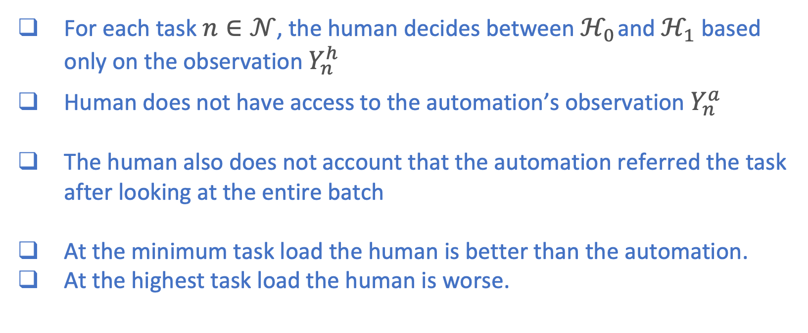
Human Automation Teams
Human Decision Models - Assumptions
For each task $n∈𝒩$, the human decides between $ℋ_{0}$ and $ℋ_{1}$ based only on the observation $Y_{n}^{h}$
Human does not have access to the automation’s observation $Y_{n}^{a}$
The human also does not account that the automation referred the task after looking at the entire batch
At the minimum task load the human is better than the automation.
At the highest task load the human is worse.

Slide 20
Human Automation Teams
System Model
Batch of Tasks
Automation
Supervisor
Human
Decision model
Observation model
Observation model
Decision model
Task load
Dependence
Referral Strategy
Classification Decisions

Slide 21
Human Automation Teams
System Model
Batch of Tasks
Automation
Supervisor
Human
Decision model
Observation model
Observation model
Decision model
Task load
Dependence
Referral Strategy
Difficult or
Unavailable
Classification Decisions

Slide 22
Human Automation Teams
System Model
Batch of Tasks
Automation
Supervisor
Human
Task load dependent classifier performance model
Decision model
Observation model
Referral Strategy
Classification Decisions
Just use what can be
measured

Slide 23
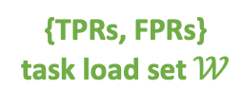
Human Automation Teams
System Model
Batch of Tasks
Automation
Supervisor
Human
Task load dependent classifier performance model
Decision model
Observation model
Referral Strategy
{TPRs, FPRs}
task load set $𝒲$
Classification Decisions

Slide 24

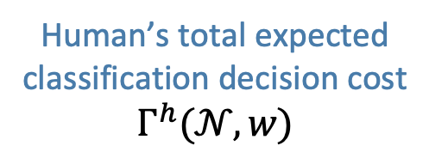
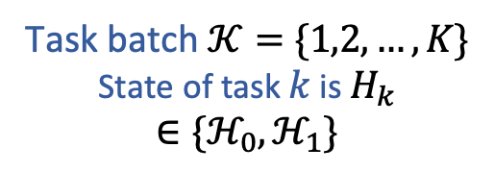

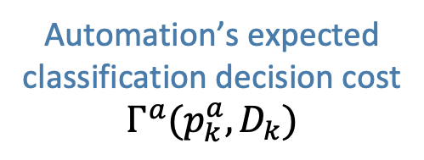


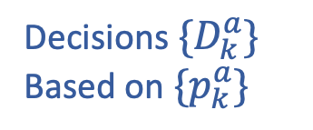


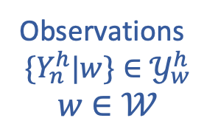

Human Automation Teams
System Model and Notation
Task batch $𝒦=\{1,2,…,K\}$
State of task $k$ is $H_{k}∈\{ℋ_{0},ℋ_{1}\}$
$$π_{i}=P(H_{k}=ℋ_{i}),i∈0,1$$
Automation
Human
Supervisor
Decisions $\{D_{k}^{a}\}$
Based on $\{p_{k}^{a}\}$
Observations
$$\{Y_{k}^{a}\}∈𝒴^{a}$$
$$𝒦$$
$$𝒩$$
Observations
$$\{Y_{n}^{h}|w\}∈𝒴_{w}^{h}$$
$$w∈𝒲$$
Decision set $\{D_{n}^{h}\}$
satisfying
the Perf. Model
Perf. Model
$$\left\{P_{tp}^{h}(w),P_{tp}^{h}(w)\right\}$$
$$w∈𝒲$$
Referral Strategy
Automation’s expected classification decision cost
$Γ^{a}(p_{k}^{a},D_{k})$
Classification Decisions
Human’s total expected classification decision cost
$$Γ^{h}(𝒩,w)$$
$$\{D_{k}^{a}\}_{k∈𝒦∖𝒩}∪\{D_{n}^{h}\}_{n∈𝒩}$$

Slide 25

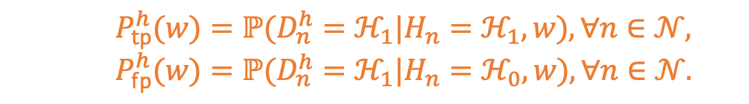
Human Automation Teams
System Model and Notation
Task batch $𝒦=\{1,2,…,K\}$
State of task $k$ is $H_{k}∈\{ℋ_{0},ℋ_{1}\}$
$$π_{i}=P(H_{k}=ℋ_{i}),i∈0,1$$
Automation
Human
Supervisor
Decisions $\{D_{k}^{a}\}$
Based on $\{p_{k}^{a}\}$
Observations
$$\{Y_{k}^{a}\}∈𝒴^{a}$$
$$𝒦$$
$$𝒩$$
Observations
$$\{Y_{n}^{h}|w\}∈𝒴_{w}^{h}$$
$$w∈𝒲$$
Decision set $\{D_{n}^{h}\}$
satisfying
the Perf. Model
Perf. Model
$$\left\{P_{tp}^{h}(w),P_{tp}^{h}(w)\right\}$$
$$w∈𝒲$$
Referral Strategy
Automation’s expected classification decision cost
$Γ^{a}(p_{k}^{a},D_{k})$
Classification Decisions
Human’s total expected classification decision cost
$$Γ^{h}(𝒩,w)$$
$$\{D_{k}^{a}\}_{k∈𝒦∖𝒩}∪\{D_{n}^{h}\}_{n∈𝒩}$$
$P_{tp}^{h}(w)=ℙ(D_{n}^{h}=ℋ_{1}|H_{n}=ℋ_{1},w),∀n∈𝒩,$
$P_{fp}^{h}(w)=ℙ(D_{n}^{h}=ℋ_{1}|H_{n}=ℋ_{0},w),∀n∈𝒩.$

Slide 26
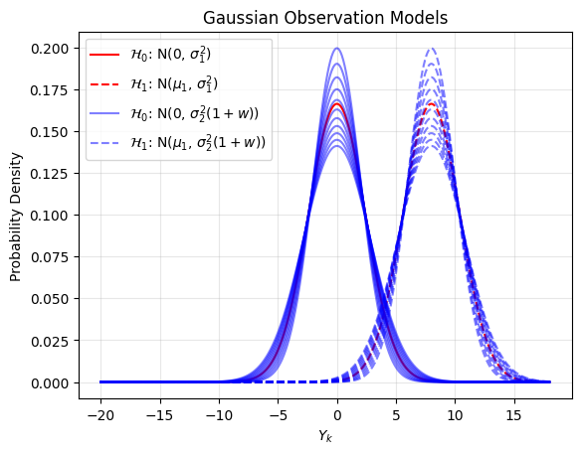

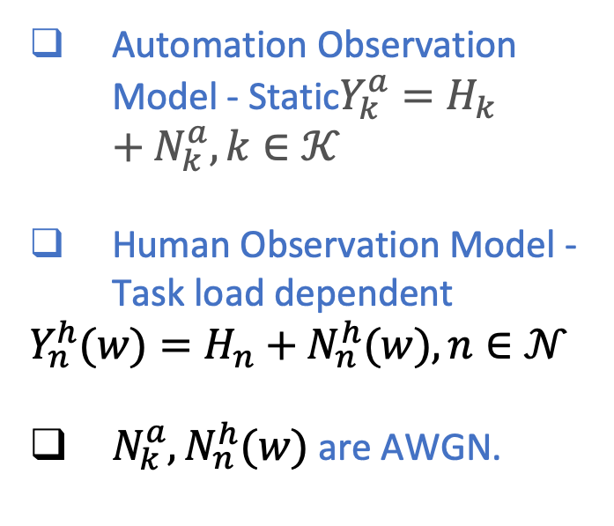



Human Automation Teams
Observation and Performance Models : Example
Automation Observation Model - Static$Y_{k}^{a}=H_{k}+N_{k}^{a},k∈𝒦$
Human Observation Model - Task load dependent
$$Y_{n}^{h}(w)=H_{n}+N_{n}^{h}(w),n∈𝒩$$
$N_{k}^{a},N_{n}^{h}(w)$ are AWGN.
$$w=1$$
$$w=10$$
$$ℋ_{0}$$
$$ℋ_{1}$$

Slide 27
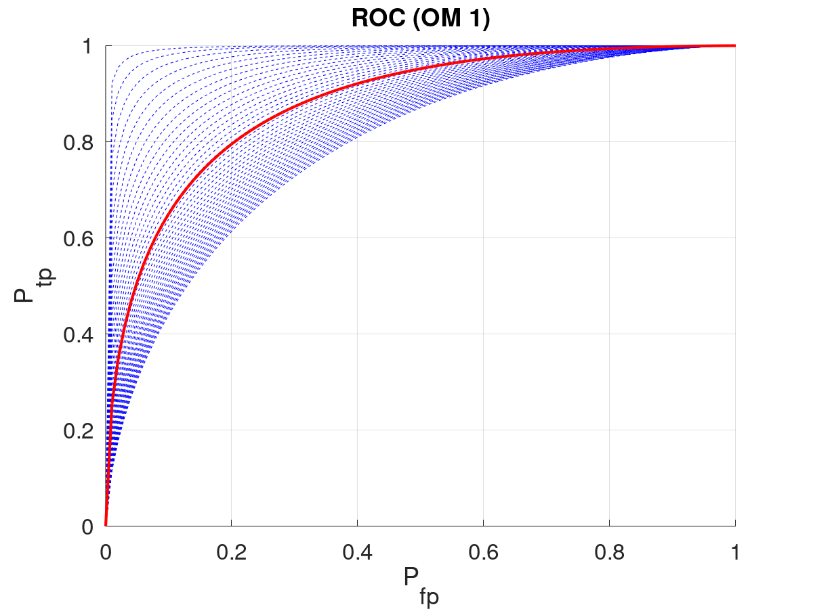
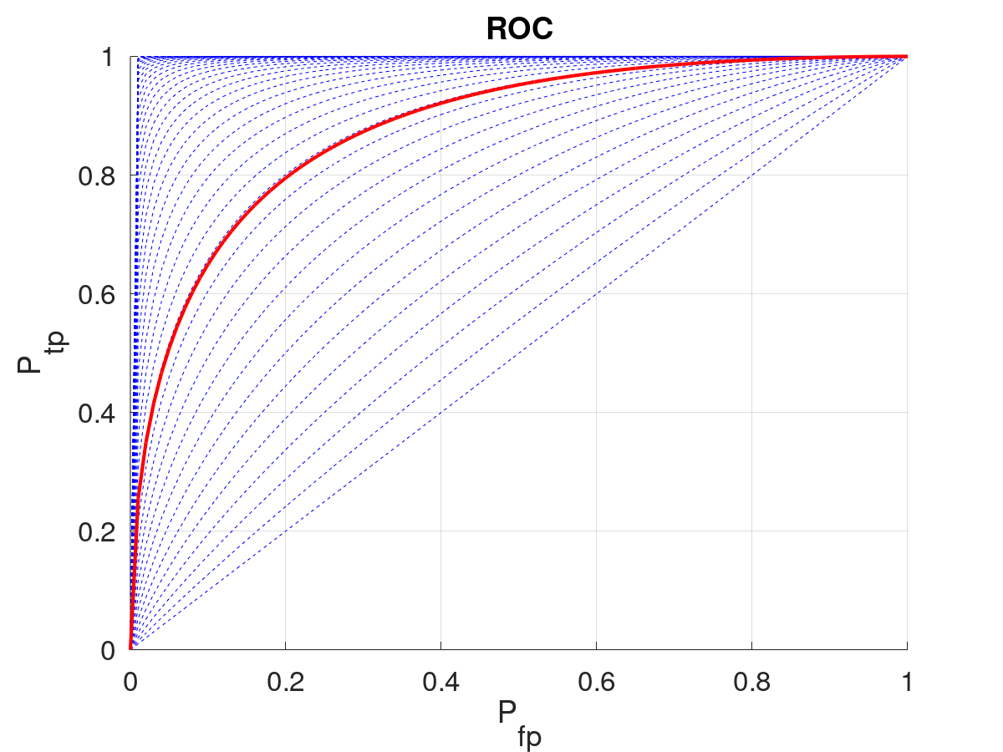
Human Automation Teams
Observation and Performance Models : Example

Slide 28
Human Automation Teams
Gaussian Observation Models
Gaussian models are used in the literature to represent decision making under uncertainty.
Also relevant in applications involving high dimensional inputs (such as images) classified using neural networks.
The weights and input to the output layer may be assumed to be Gaussian by applying a mean field approximation [Schoenholz 2022].
S. S. Schoenholz, J. Gilmer, S. Ganguli, and S.-J. Dickstein, “Deep
information propagation,” in International Conference on Learning
Representations, 2022.

Slide 29
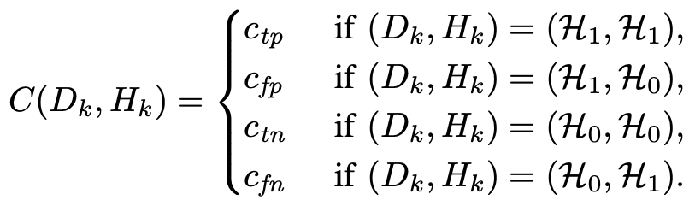
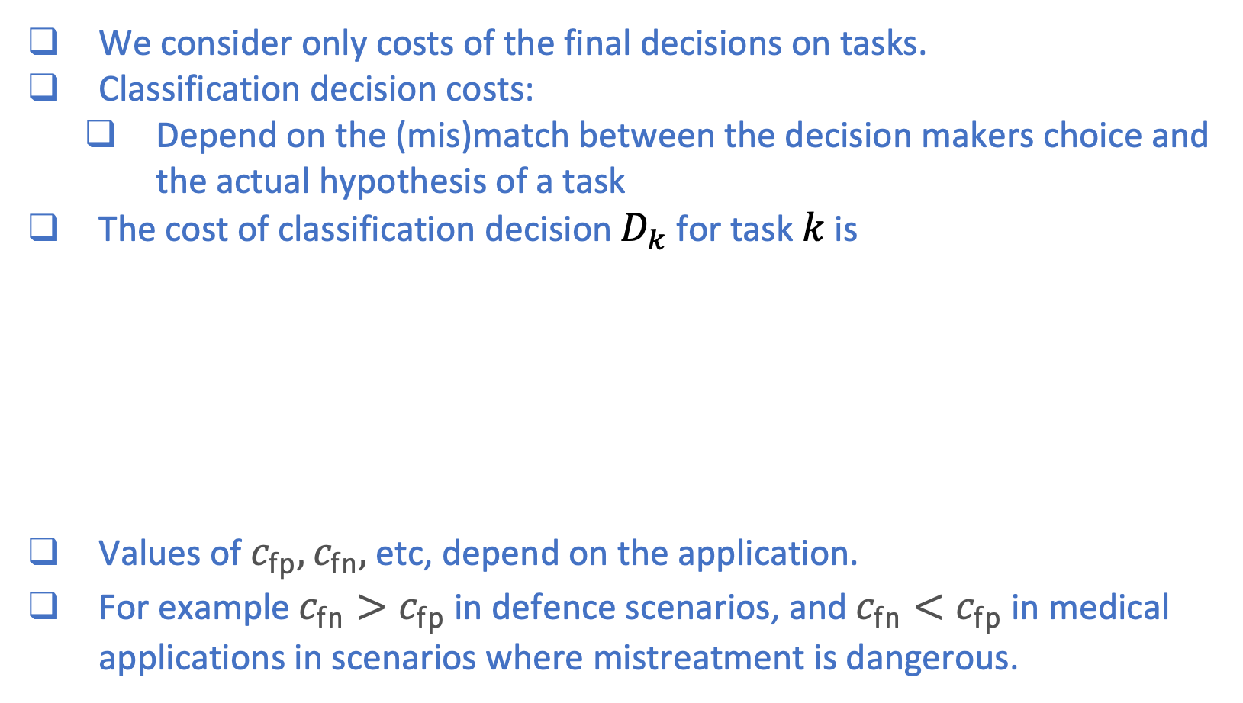
Human Automation Teams
Problem Formulation - Decision Costs
We consider only costs of the final decisions on tasks.
Classification decision costs:
Depend on the (mis)match between the decision makers choice and the actual hypothesis of a task
The cost of classification decision $D_{k}$ for task $k$ is
Values of $c_{fp},c_{fn},$ etc, depend on the application.
For example $c_{fn}>c_{fp}$ in defence scenarios, and $c_{fn}<c_{fp}$ in medical applications in scenarios where mistreatment is dangerous.

Slide 30
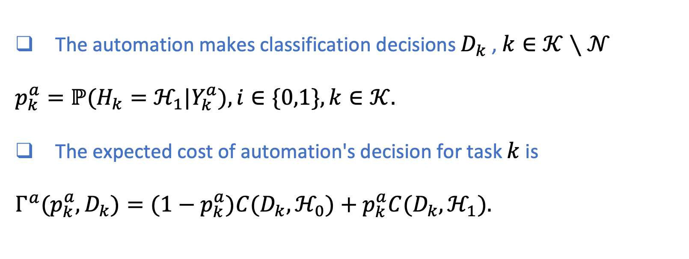
Human Automation Teams
Automation’s Decision Costs
The automation makes classification decisions $D_{k}$ , $k∈𝒦∖𝒩$
$$p_{k}^{a}=ℙ(H_{k}=ℋ_{1}|Y_{k}^{a}),i∈\{0,1\},k∈𝒦.$$
The expected cost of automation's decision for task $k$ is
$$Γ^{a}(p_{k}^{a},D_{k})=(1−p_{k}^{a})C(D_{k},ℋ_{0})+p_{k}^{a}C(D_{k},ℋ_{1}).$$

Slide 31
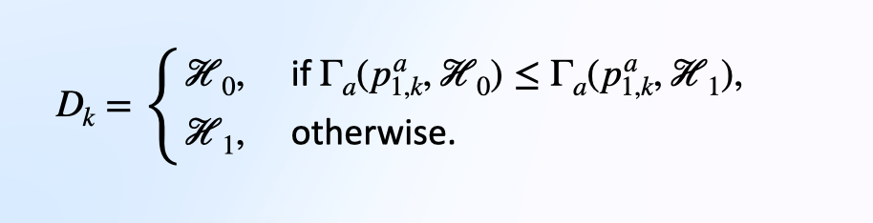
Human Automation Teams
Automation’s Decision Costs
The automation makes classification decisions $D_{k}$ , $k∈𝒦∖𝒩$
$$p_{k}^{a}=ℙ(H_{k}=ℋ_{1}|Y_{k}^{a}),i∈\{0,1\},k∈𝒦.$$
The expected cost of automation's decision for task $k$ is
$$Γ^{a}(p_{k}^{a},D_{k})=(1−p_{k}^{a})C(D_{k},ℋ_{0})+p_{k}^{a}C(D_{k},ℋ_{1}).$$

Slide 32
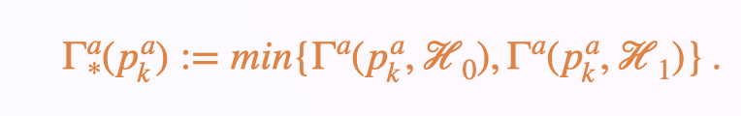
Human Automation Teams
Automation’s Decision Costs
The automation makes classification decisions $D_{k}$ , $k∈𝒦∖𝒩$
$$p_{k}^{a}=ℙ(H_{k}=ℋ_{1}|Y_{k}^{a}),i∈\{0,1\},k∈𝒦.$$
The expected cost of automation's decision for task $k$ is
$$Γ^{a}(p_{k}^{a},D_{k})=(1−p_{k}^{a})C(D_{k},ℋ_{0})+p_{k}^{a}C(D_{k},ℋ_{1}).$$

Slide 33
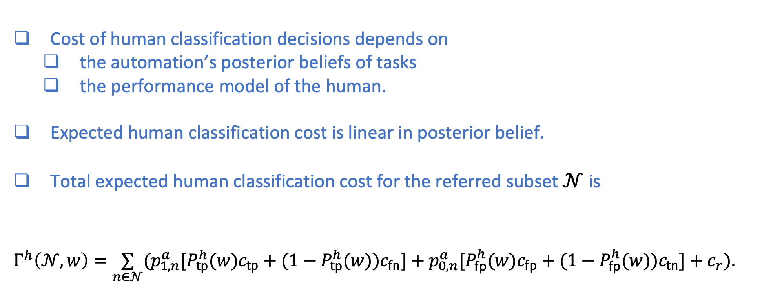
Human Automation Teams
Human Decision Cost
Cost of human classification decisions depends on
the automation’s posterior beliefs of tasks
the performance model of the human.
Expected human classification cost is linear in posterior belief.
Total expected human classification cost for the referred subset $𝒩$ is
$$Γ^{h}\left(𝒩,w\right)=\underset{n∈𝒩}{∑}(p_{1,n}^{a}[P_{tp}^{h}(w)c_{tp}+(1−P_{tp}^{h}(w))c_{fn}]+p_{0,n}^{a}[P_{fp}^{h}(w)c_{fp}+(1−P_{fp}^{h}(w))c_{tn}]+c_{r}).$$

Slide 34
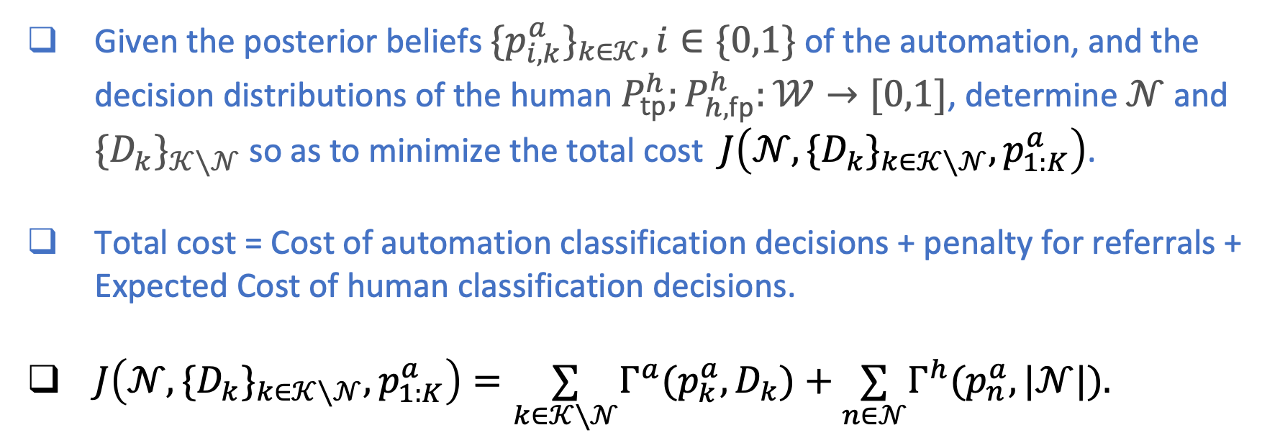
Human Automation Teams
Optimization Problem
Given the posterior beliefs $\{p_{i,k}^{a}\}_{k∈𝒦},i∈\{0,1\}$ of the automation, and the decision distributions of the human $P_{tp}^{h};P_{h,fp}^{h}:𝒲→[0,1]$, determine $𝒩$ and $\{D_{k}\}_{𝒦∖𝒩}$ so as to minimize the total cost $J\left(𝒩,\{D_{k}\}_{k∈𝒦∖𝒩},p_{1:K}^{a}\right)$.
Total cost = Cost of automation classification decisions + penalty for referrals + Expected Cost of human classification decisions.
$J\left(𝒩,\{D_{k}\}_{k∈𝒦∖𝒩},p_{1:K}^{a}\right)=\underset{k∈𝒦∖𝒩}{∑}Γ^{a}(p_{k}^{a},D_{k})+\underset{n∈𝒩}{∑}Γ^{h}(p_{n}^{a},|𝒩|).$

Slide 35
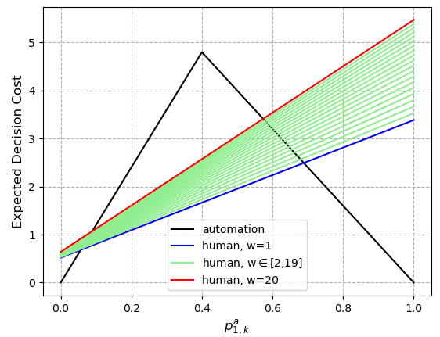
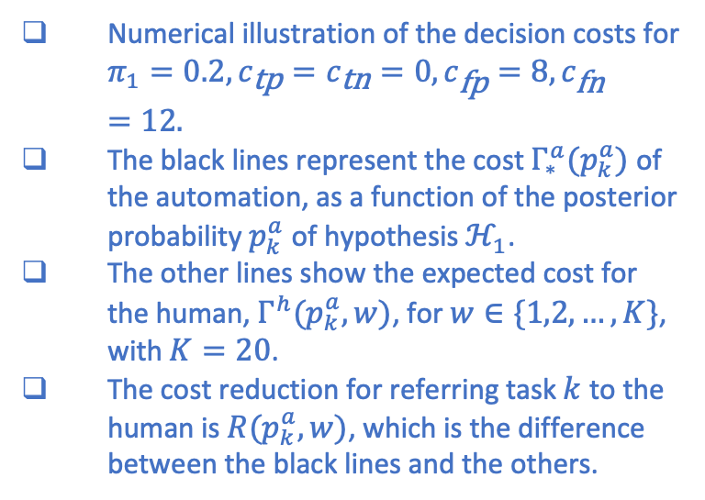


Human Automation Teams
Numerical Example
Numerical illustration of the decision costs for $π_{1}=0.2,c_{\text{tp}}=c_{\text{tn}}=0,c_{\text{fp}}=8,c_{\text{fn}}=12.$
The black lines represent the cost $Γ_{∗}^{a}(p_{k}^{a})$ of the automation, as a function of the posterior probability $p_{k}^{a}$ of hypothesis $ℋ_{1}$.
The other lines show the expected cost for the human, $Γ^{h}(p_{k}^{a},w)$, for $w∈\{1,2,…,K\}$, with $K=20$.
The cost reduction for referring task $k$ to the human is $R(p_{k}^{a},w)$, which is the difference between the black lines and the others.
$$Γ_{∗}^{a}(p)$$
$$Γ^{h}(p,w)$$

Slide 36
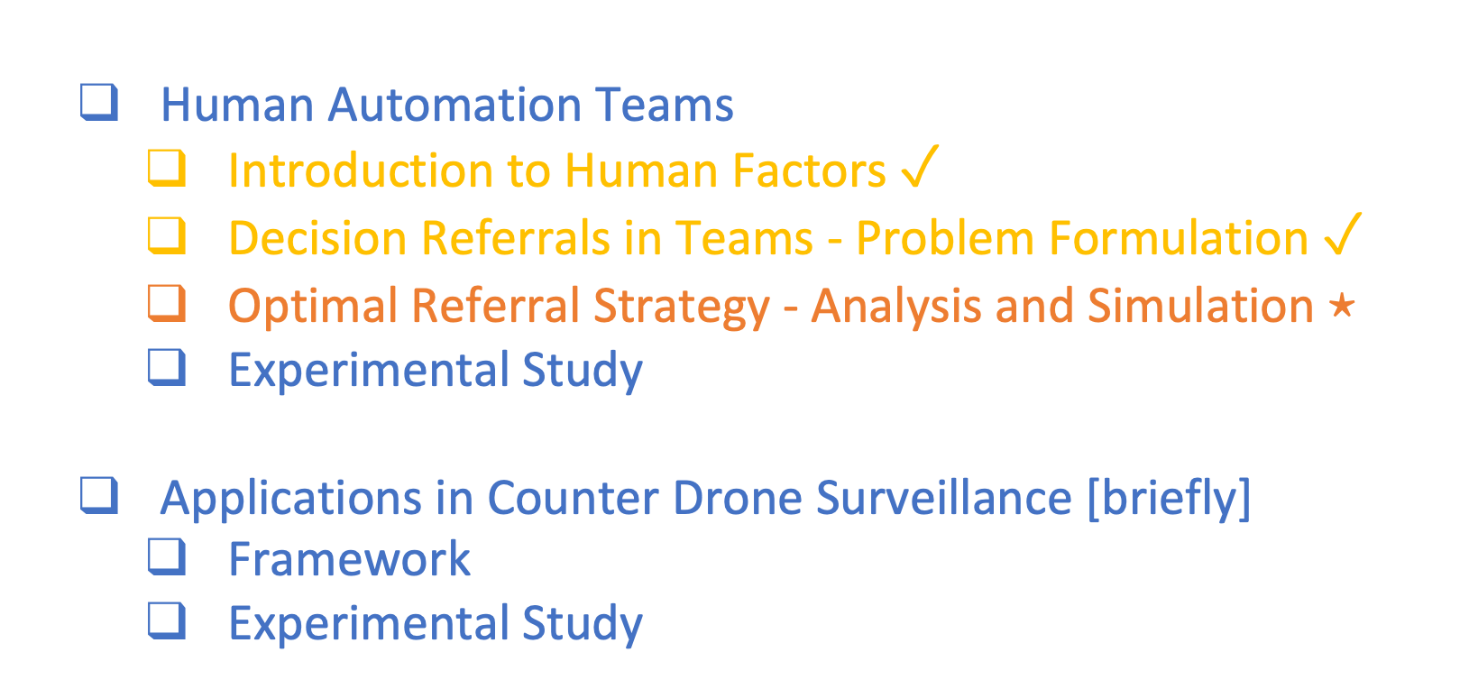
Agenda
Human Automation Teams
Introduction to Human Factors $✓$
Decision Referrals in Teams - Problem Formulation $✓$
Optimal Referral Strategy - Analysis and Simulation $⋆$
Experimental Study
Applications in Counter Drone Surveillance [briefly]
Framework
Experimental Study

Slide 37
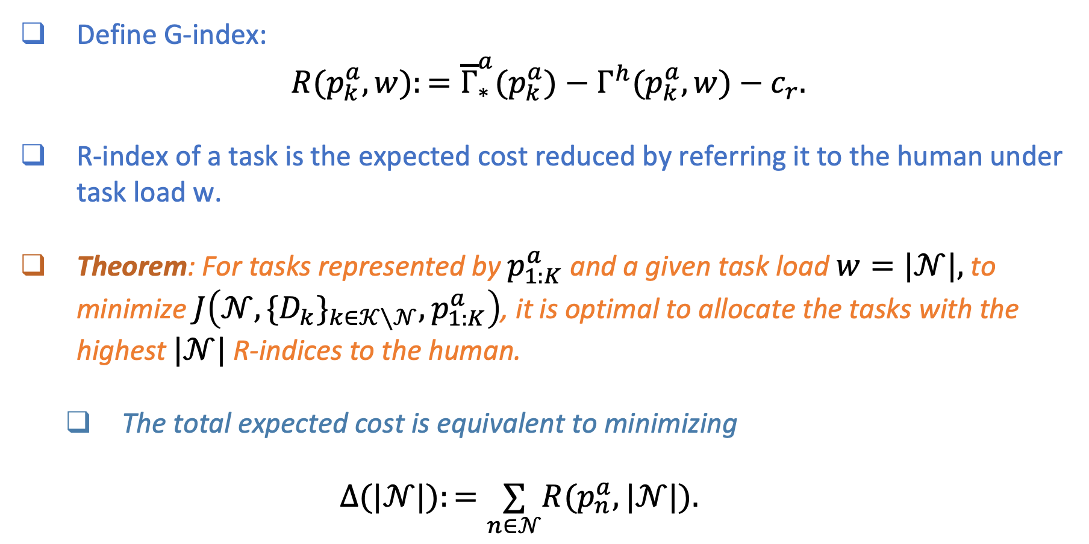

Human Automation Teams
Optimal Decision Referral Strategy under fixed task load
Define G-index:
$R(p_{k}^{a},w):={\overline{Γ}}_{∗}^{a}(p_{k}^{a})−Γ^{h}(p_{k}^{a},w)−c_{r}.$
R-index of a task is the expected cost reduced by referring it to the human under task load w.
Theorem: For tasks represented by $p_{1:K}^{a}$ and a given task load $w=|𝒩|,$ to minimize $J\left(𝒩,\{D_{k}\}_{k∈𝒦∖𝒩},p_{1:K}^{a}\right)$, it is optimal to allocate the tasks with the highest $|𝒩|$ R-indices to the human.
The total expected cost is equivalent to minimizing
$$Δ(|𝒩|):=\underset{n∈𝒩}{∑}R(p_{n}^{a},|𝒩|).$$
$$∙$$

Slide 38
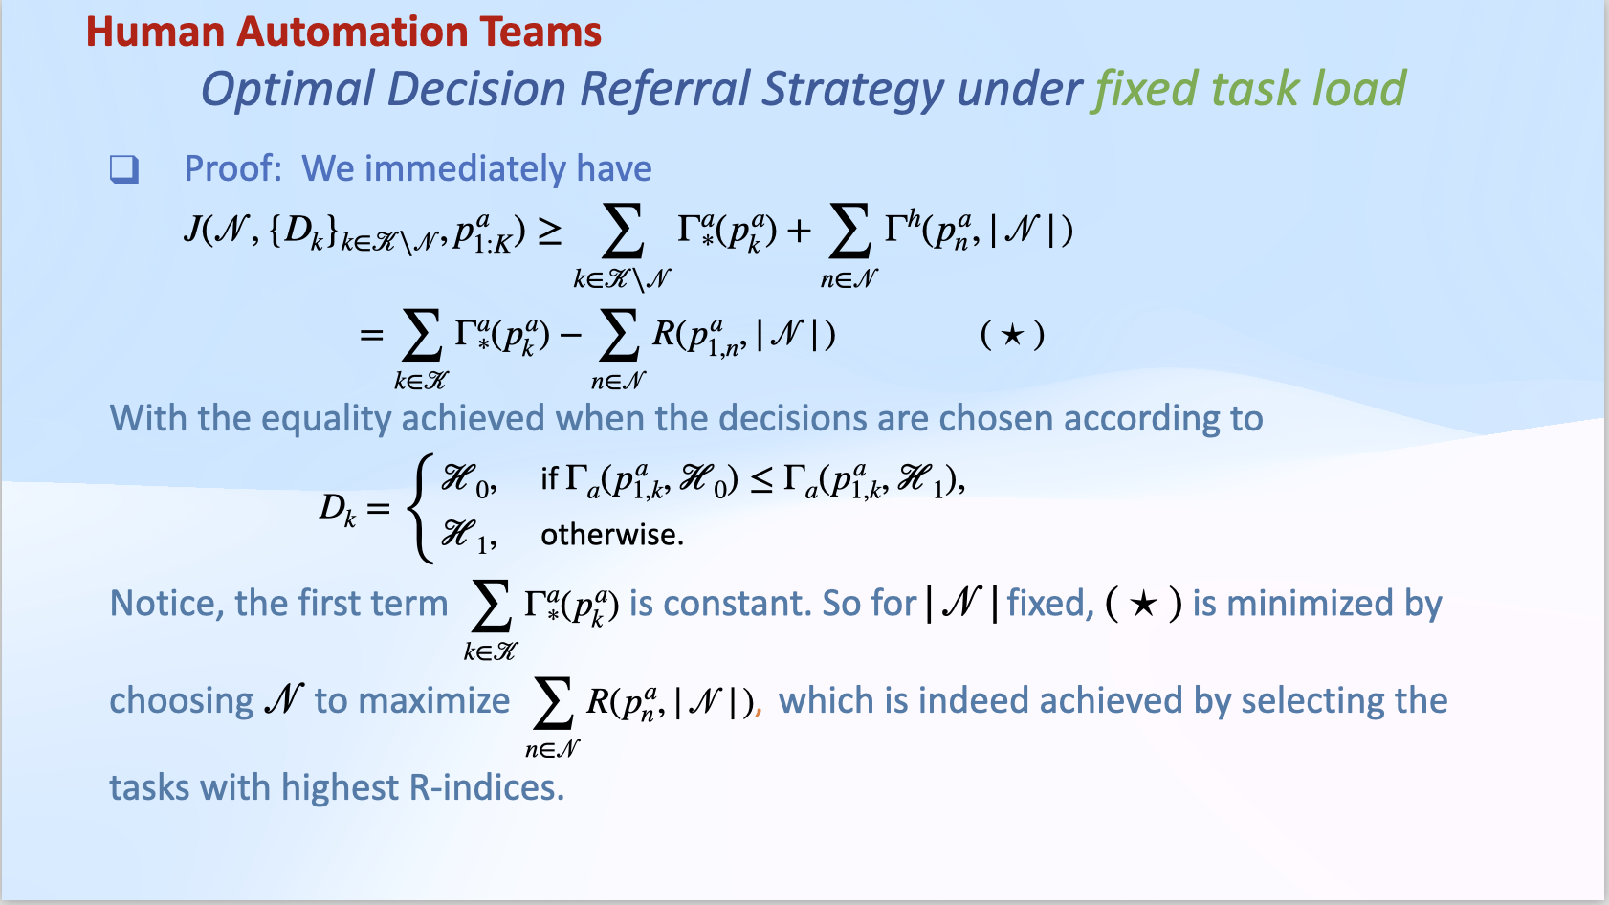

Slide 39
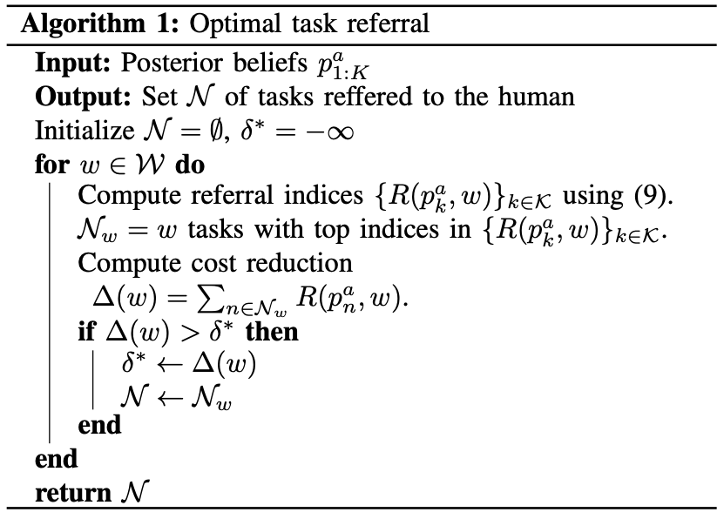
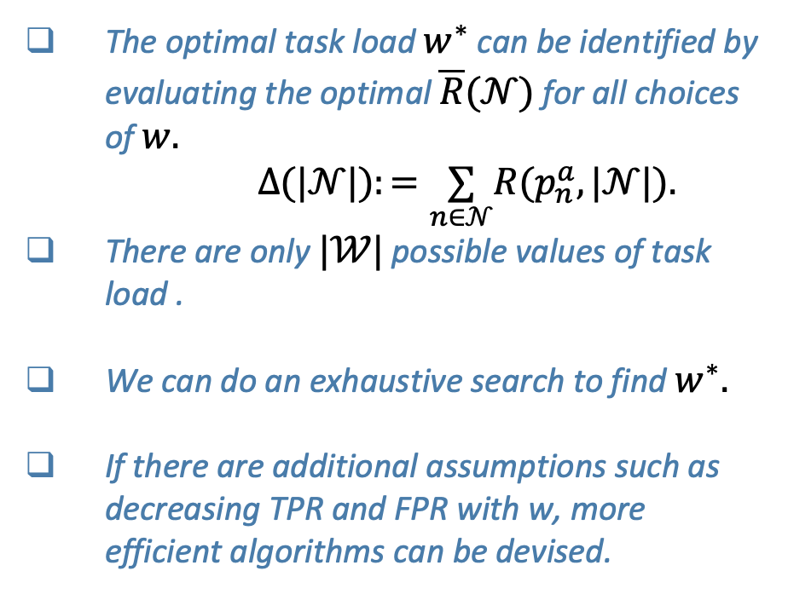
Human Automation Teams
Optimal Decision Referral Strategy
The optimal task load $w^{∗}$ can be identified by evaluating the optimal $\overline{R}(𝒩)$ for all choices of $w.$
$Δ(|𝒩|):=\underset{n∈𝒩}{∑}R(p_{n}^{a},|𝒩|).$
There are only $|𝒲|$ possible values of task load .
We can do an exhaustive search to find $w^{∗}.$
If there are additional assumptions such as decreasing TPR and FPR with w, more efficient algorithms can be devised.

Slide 40
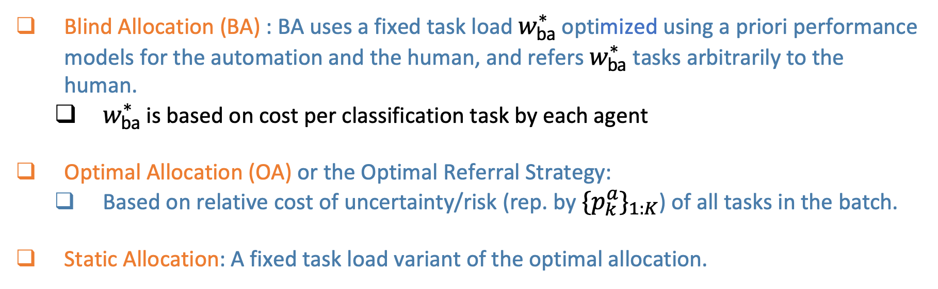
Human Automation Teams
Proposed Referral Strategies
Blind Allocation (BA) : BA uses a fixed task load $w_{ba}^{∗}$ optimized using a priori performance models for the automation and the human, and refers $w_{ba}^{∗}$ tasks arbitrarily to the human.
$w_{ba}^{∗}$ is based on cost per classification task by each agent
Optimal Allocation (OA) or the Optimal Referral Strategy:
Based on relative cost of uncertainty/risk (rep. by $\{p_{k}^{a}\}_{1:K}$) of all tasks in the batch.
Static Allocation: A fixed task load variant of the optimal allocation.

Slide 41
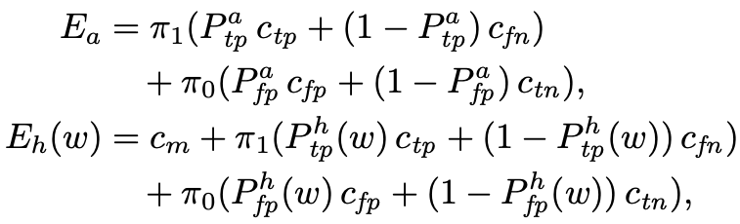
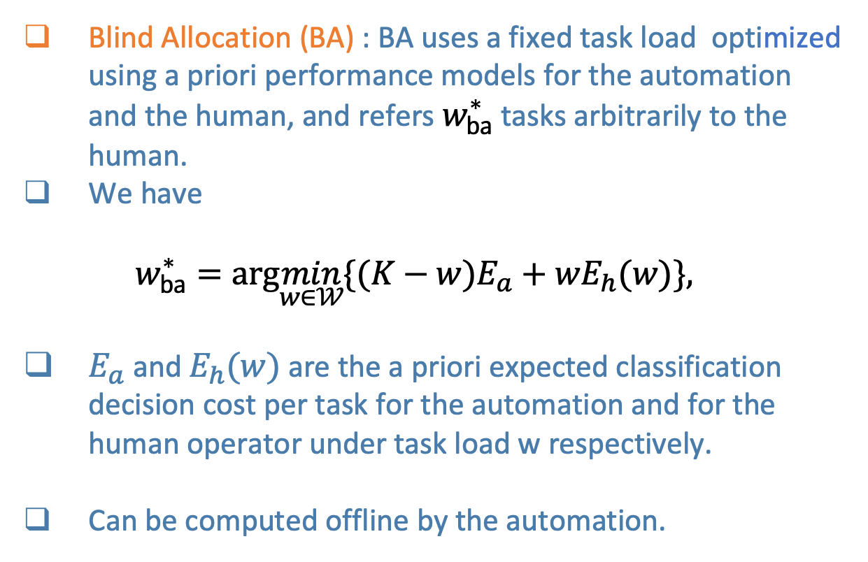
Human Automation Teams
Blind Allocation
Blind Allocation (BA) : BA uses a fixed task load optimized using a priori performance models for the automation and the human, and refers $w_{ba}^{∗}$ tasks arbitrarily to the human.
We have
$w_{ba}^{∗}=arg\min_{w∈𝒲}\{(K−w)E_{a}+wE_{h}(w)\},$
$E_{a}$ and $E_{h}(w)$ are the a priori expected classification decision cost per task for the automation and for the human operator under task load w respectively.
Can be computed offline by the automation.

Slide 42

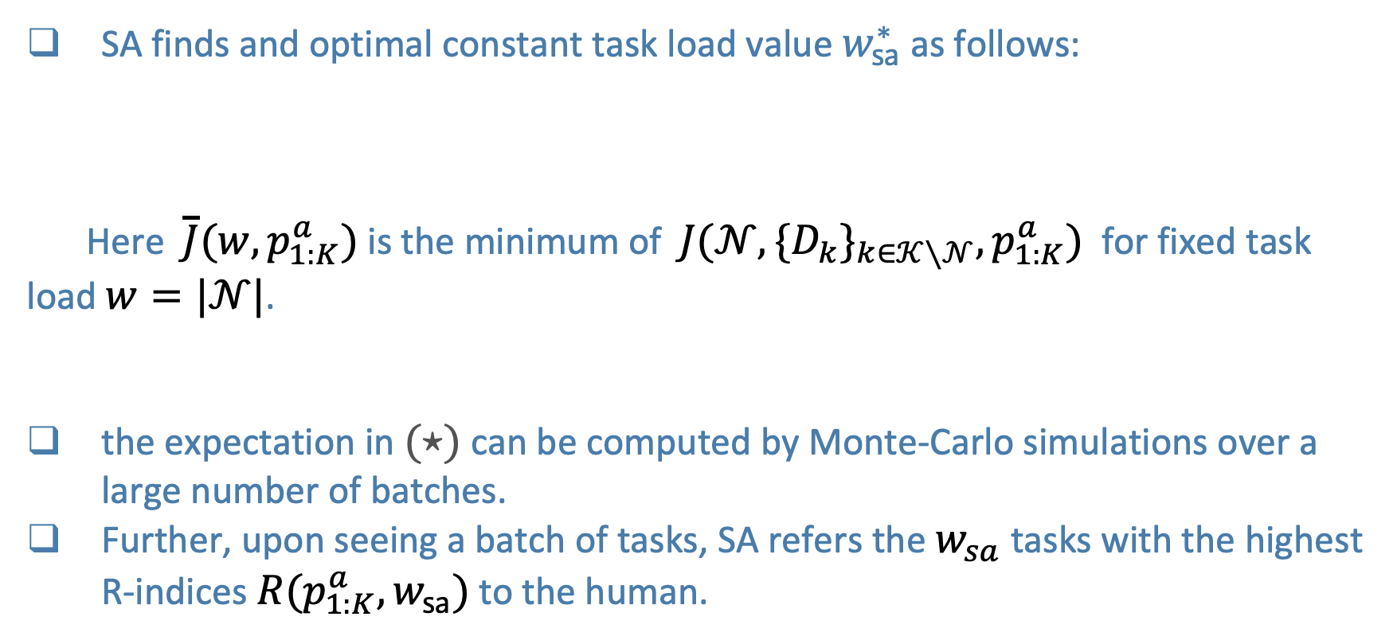
Human Automation Teams
Static Allocation
SA finds and optimal constant task load value $w_{sa}^{∗}$ as follows:
Here $\overline{J}(w,p_{1:K}^{a})$ is the minimum of $J(𝒩,\{D_{k}\}_{k∈𝒦∖𝒩},p_{1:K}^{a})$ for fixed task load $w=|𝒩|$.
the expectation in $(⋆)$ can be computed by Monte-Carlo simulations over a large number of batches.
Further, upon seeing a batch of tasks, SA refers the $w_{sa}$ tasks with the highest R-indices $R(p_{1:K}^{a},w_{sa})$ to the human.

Slide 43
Human Automation Teams
Summary of Proposed Strategies
 | Blind Allocation | Optimal Allocation | Static Allocation
Allocation dependent on human capability? | Yes, for the task loads. No, for individual tasks. | Yes | Yes
Task load | Constant across batches | Varies with batches | Constant across batches
Computation | Offline | Online | Task load computed offline. Optimal task subsets computed online.

Slide 44
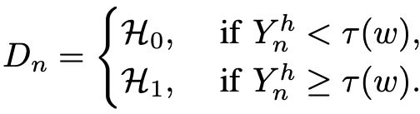
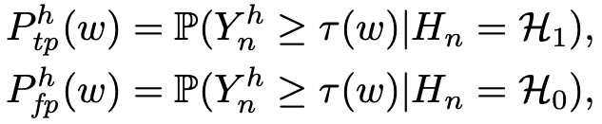

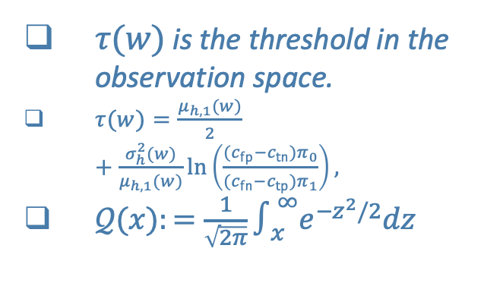
Human Automation Teams
Numerical Simulations
Assume Gaussian Observation Models
Human observation model has task load dependent noise variance
Assume that human is an threshold classifier with decision rule
$P_{fp}^{h}(w)=𝒬\left(\frac{τ(w)}{σ_{h}(w)}\right),$ $P_{tp}^{h}(w)=𝒬\left(\frac{τ(w)−μ_{h,1}(w)}{σ_{h}(w)}\right).$
$τ(w)$ is the threshold in the observation space.
$τ(w)=\frac{μ_{h,1}(w)}{2}+\frac{σ_{h}^{2}(w)}{μ_{h,1}(w)}ln\left(\frac{(c_{fp}−c_{tn})π_{0}}{(c_{fn}−c_{tp})π_{1}}\right),$
$𝒬(x):=\frac{1}{\sqrt{2π}}∫_{x}^{∞}e^{−z^{2}/2}dz$

Slide 45
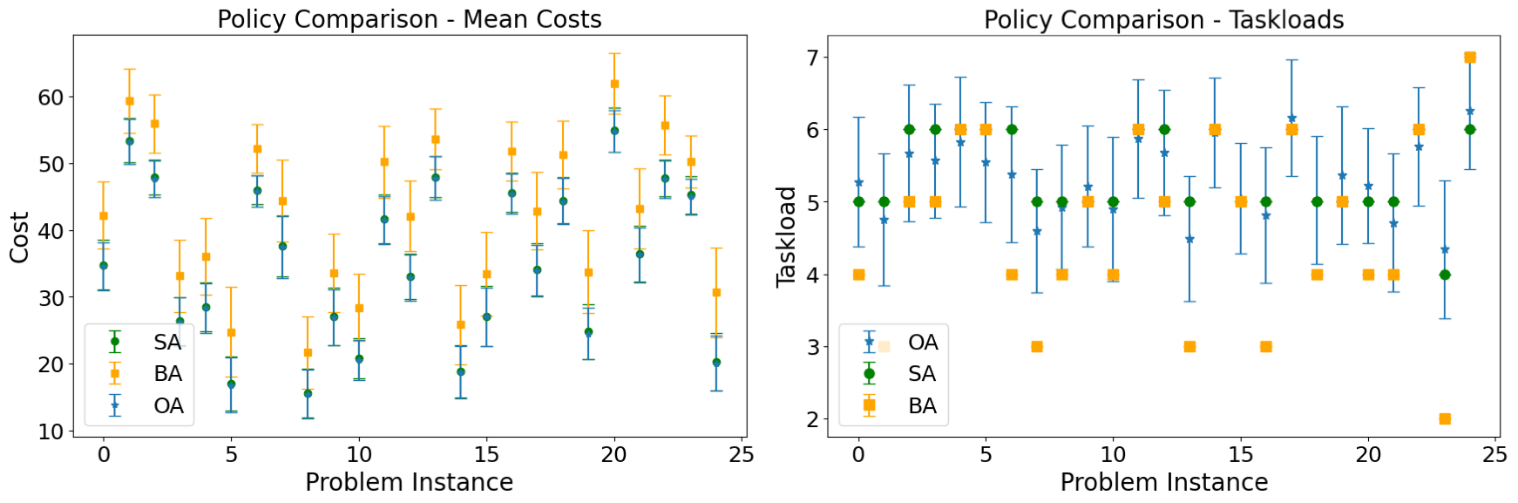
Human Automation Teams
Numerical Examples
Comparison of referral policies for 25 distinct problem instances, assuming the human has a Gaussian observation model. The batch size is K = 20. [left] Both OA and SA have similar performance and better
average decision cost than BA. [right] The task load under BA shows large variations across instances.

Slide 46
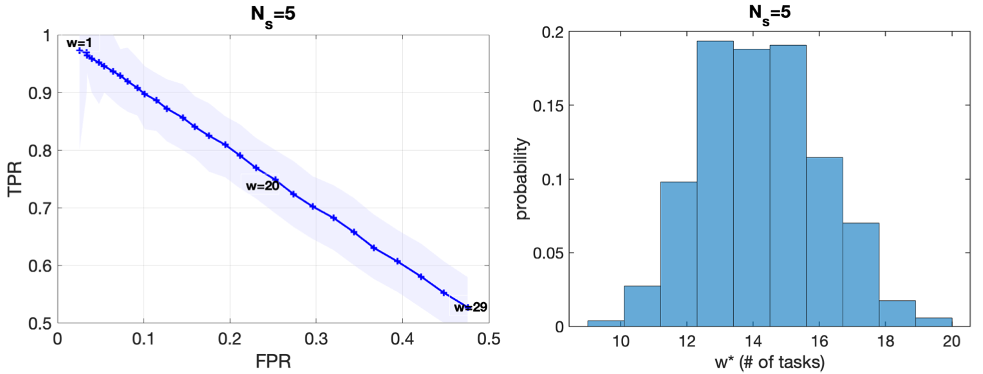
Human Automation Teams
Numerical Examples
[left] Simulated average (TPR, FPR) points for each task load and their inter-quartile ranges obtained from several randomly generated sets of 5 sample batches for each task load. [right] Distribution of expected optimal task load allotted by OA strategy to the human operator across all the sets.

Slide 47
Human Automation Teams
Insights from Simulation Study
SA and OA have similar performance.
We need to compare OA and BA in a more realistic setting.
The simulations suggest that consecutive task load levels must be chosen such that mutual conflation is avoided while accommodating an estimation error tolerance ϵmax < 0.1 on both sides.
This might be achieved at least 5 measurements for each task load.
The number of human participants for TPR, FPR estimation can be decided based on this information.

Slide 48
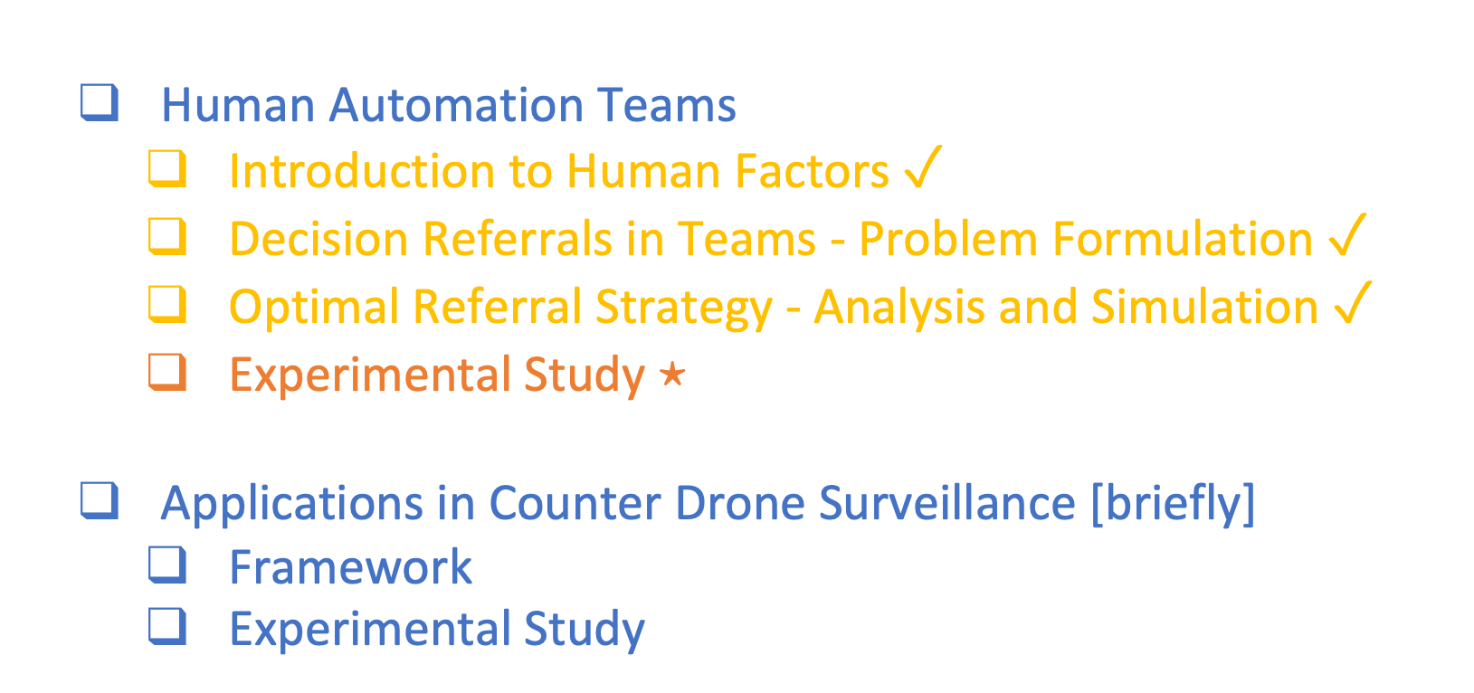
Agenda
Human Automation Teams
Introduction to Human Factors $✓$
Decision Referrals in Teams - Problem Formulation $✓$
Optimal Referral Strategy - Analysis and Simulation $✓$
Experimental Study $⋆$
Applications in Counter Drone Surveillance [briefly]
Framework
Experimental Study

Slide 49
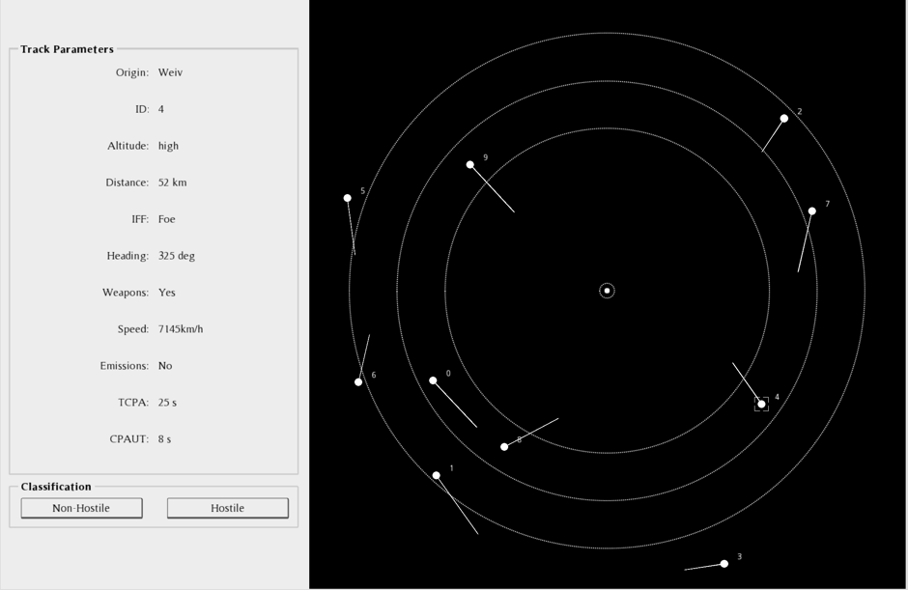
Human Automation Teams
Experimental Study with Human Subjects
Experimental setup: A simulation of a radar screen showing multiple mobile targets.
Clicking a target displays information such as speed, altitude, etc, on the central pane.
The operator has to decide the correct label (Hostile or Non-hostile)
and presses one of the two classification buttons.

Slide 50
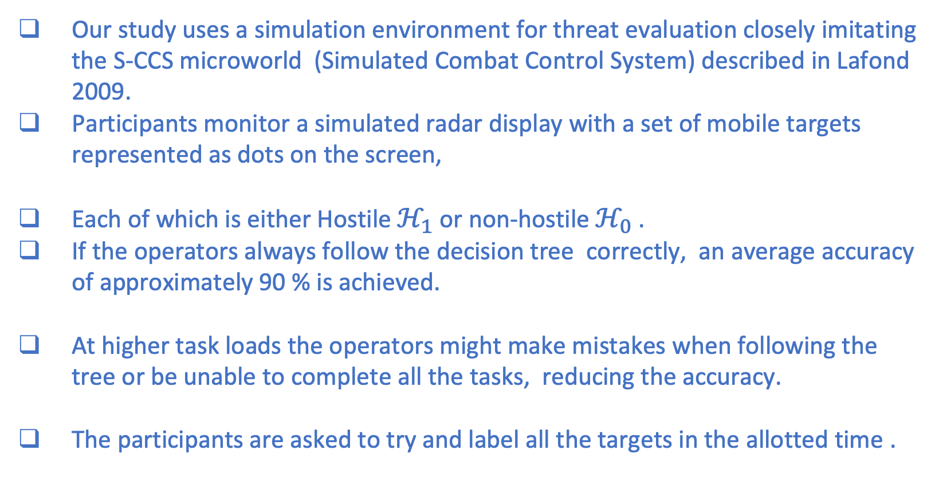
Human Automation Teams
Experimental Setup
Our study uses a simulation environment for threat evaluation closely imitating the S-CCS microworld (Simulated Combat Control System) described in Lafond 2009.
Participants monitor a simulated radar display with a set of mobile targets represented as dots on the screen,
Each of which is either Hostile $ℋ_{1}$ or non-hostile $ℋ_{0}$ .
If the operators always follow the decision tree correctly, an average accuracy of approximately 90 % is achieved.
At higher task loads the operators might make mistakes when following the tree or be unable to complete all the tasks, reducing the accuracy.
The participants are asked to try and label all the targets in the allotted time .
D. Lafond, J. Champagne, G. Hervet, J.-F. Gagnon, S. Tremblay, and R. Rousseau, “Decision analysis using policy capturing and process tracing techniques in a simulated naval air-defense task,” Human Factors
and Ergonomics Society Annual Meeting, vol. 53, no. 18, pp. 1220–1224, 2009.

Slide 51
Human Automation Teams
Experimental Study with Human Subjects
To evaluate the practical effectiveness of the proposed referral policy.
Experiment 1 - Parameter Estimation
Participant group size - 28 = 19 males + 9 females
Valid samples - 18
Valid sample threshold - Completion of 55 % of the provided tasks
Experiment 2 - Comparison of Optimal Allocation vs Blind Allocation
Participant group size - 15 = 7 males + 8 females
Valid samples - 15
$ 25 compensation for one hour experiment session

Slide 52
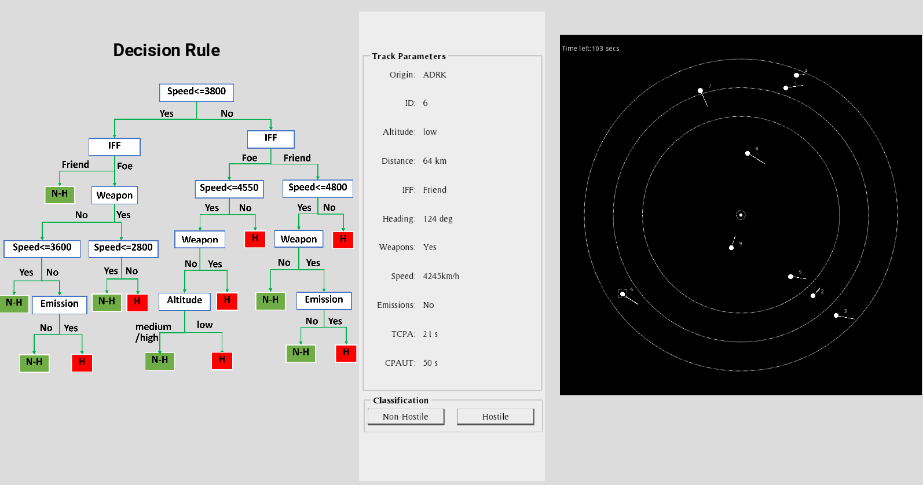
Human Automation Teams
Experimental Study with Human Subjects
Experimental setup: A simulation of a radar screen showing multiple mobile targets.
Clicking a target displays information such as speed, altitude, etc, on the central pane.
The operator follows the decision tree to decide the correct label (Hostile or Non-hostile)
and presses one of the two classification buttons.

Slide 53
Human Automation Teams
Experiment 1 - Parameter Estimation
Need to estimate TPR and FPR for different task loads.
27 two minute rounds with batch sizes 6, 9, 12, or 15 tasks in each round.
Rest after each round as needed by the operator and click ‘Next’.
First three rounds are for training and are not used for the estimation.

Slide 54

Human Automation Teams
Experiment 1: Estimation of Human TPR and FPR
Experiment 1: [left] TPR and FPR measurements from all 28 participants for four task loads 6,9,12,15, with inter-quartile (IQR) ranges along with the outliers. [right] Comparison of empirical estimates from 18 valid samples (who completed at least 55% of all allocated tasks) to simulation based estimates made prior to the experiment.

Slide 55

Human Automation Teams
Experiment 2 - OA vs. BA
To compare OA and BA we used an independent participant group.
A ``within-subject'' experiment design was used.
That means, each operator is presented multiple rounds with tasks referred by BA policy, as well as rounds with tasks referred by OA policy.
Overall, each operator goes through a sequence of 24 two-minute rounds, 12 each for BA and OA in random order.
Batch size K=30 is was used in all rounds.
BA policy maintains a fixed task load $w_{ba}^{∗}=7(\text{out} \text{of}30)$ across all batches.

Slide 56


Human Automation Teams
Experiment 2: Statistical Analysis
Null Hypothesis: $μ_{BA}−μ_{OA}=0$,
Alternate Hypothesis: $μ_{BA}−μ_{OA}>0$.
Paired t-test conducted to compare performances.
Worst case analysis: t-statistic of 4.99 and p-value of 0.0002
Experiment 2 - Performance measurements (inter-quartile ranges)
of blind allocation and optimal allocation policies for all participants.

Slide 57
Human Automation Teams
Conclusion
Three referral strategies were proposed.
The proposed methods only requires the true and false positive rates of the ``human classifier'' as a function of task load.
rather than a model of human decision making.
Results show that OA performs significantly better than BA.
SA may provide similar performance in applications where frequent changes in human task load are undesirable.

Slide 58
Human Automation Teams
Conclusion
In practice, the automation classifier is trained on a large amount of labelled data, but its performance may degrade when there is a domain or distribution shift during the deployment.
Human performance may remain almost the same as they are naturally capable of “generalization to out-of-distribution”.
Hence, the choice must be made based on the application scenario.

Slide 59

Agenda
Human Automation Teams
Introduction to Human Factors $✓$
Decision Referrals in Teams - Problem Formulation $✓$
Optimal Referral Strategy - Analysis and Simulation $✓$
Experimental Study $✓$
Applications in Counter Drone Surveillance [briefly] $⋆$
Framework
Experimental Study

Slide 60



Application
Application to Counter Drone Networks
Enhancing Counter Drone Operations Through Human-AI Collaboration: A Hierarchical Decision-Making Framework
Problem Space
Data Acquisition and Test Setup
Radar and Optical Data
System Architecture
Results
Pub.: 42nd DASC, 2023.

Slide 61







Problem Space
Application
Application to Counter Drone Networks
Enhancing Counter Drone Operations Through Human-AI Collaboration: A Hierarchical Decision-Making Framework
GCS
Ground detection-classification
AI Engine
Human Operator
Radar
PTZ

Slide 62

Application
Application to Counter Drone Networks
Experiment Setup
Pan Tilt Zoom (PTZ) camera
Resolution-1920X1080
Pan- 360°
Tilt- -90° to 45°
Zoom- 32x optical zoom, 12x digital
FMCW Radar
Range resolution- 3.25m
Velocity resolution- 0.91m/s
Azimuth resolution- ±1°
Elevation resolution- ±3°
Update rate 10 Hz

Slide 63

Radar and Optical Data
Application
DASC, 2023.
Total Radar data:
12 hours of UAV Tracks 2 hours of Birds Tracks
1 hour of other ground targets (car, human) tracks.
Total optical data:
85 videos with 207,663 UAV frames.
The range of operation: 50m to 1.2 km
Sample trajectory of (a) bird and (b) UAV captured by the ground radar system. The (c) and (d) depict samples of a bird and a UAV, respectively, extracted from the PTZ video data.

Slide 64

Application
Application to Counter Drone Networks
System Model
Overall system architecture for the proposed drone detection and classification framework. The system integrates multiple sensors, including ground radar and a PTZ camera, and employs a human-AI collaboration framework for efficient and accurate surveillance.

Slide 65



Application
Radar classifier
The classifier model integrates classical Interactive Multiple Model tracking (IMM) filter features and trajectory based features.
Radar classifier confusion matrix
 | Predicted Drone | Predicted OFO
True Drone | 94% | 6%
True OFO | 58% | 42%
Optical detector and classifier performance
Precision
0,49 | 0,36 | 0,25
Examples of true positive and false positive results obtained from the optical classifier. The top row shows instances where the classifier accurately detects and classifies UAVs, while the bottom row depicts cases where the classifier incorrectly identifies non-UAV objects as UAVs.
$$mAP_{50}$$
$$mAP_{50:95}$$

Slide 66

Referrals to Human using OA
Application
TPR | FPR
88% | 22%
Sample tasks referred to the human under the constraint that 5 tasks must be allocated to the human. All tasks referred to the human reviewer contained false positives of the AI detector. In the last one (bottom right), the UAV was missed by the detector, but a bounding box was drawn elsewhere in the frame. In the other cases, bounding boxes were falsely drawn by the detector with no flying objects in the frame.

Slide 67

POTENTIAL FUTURE WORK
Real time decision support systems.
Complex tasks that require memory, attention and executive function.
Compound tasks involving heterogenous subtasks.
Modelling fatigue along with mental workload.

Slide 68
POTENTIAL FUTURE WORK
How can such a real time DSS be verified (model, simulation based and statistical verification)?
How can we say that a DSS reduces risk and not increase it?
And with how much confidence?

Slide 69
Related Articles
K. Kaza, J. Le Ny, A. Mahajan, “Decision Referrals in Human Automation Teams: Impact of Taskload on Team Performance,” under review, IEEE Trans. on Human Machine Systems.
V. Mehta, K. Kaza, F. Dadboud, M. Bolic, I. Mantegh, “Enhancing Counter Drone Operations Through Human-AI Collaboration: A Hierarchical Decision-Making Framework,” 42nd DASC 2023 .
K. Kaza, J. Le Ny, A. Mahajan, “Decision Referrals in Human Automation Teams,” 60th IEEE CDC 2021.

Slide 70
Thank You!

Slide 71
Human Factors
Cognitive or Mental Workload
How are they assessed?
Usually measured though feed back from human operators.
Different scales based on different sets of questions asked.
Examples are Bedford scale and NASA TLX
Bedford scale - uni dimensional 10−point scale to measure operator’s spare mental capacity while completing a task.
NASA TLX - A multi-dimensional scale based on feedback regarding mental demand, physical demand, temporal demand, effort, performance, frustration level.

Slide 72

Human Factors
Cognitive Workload
Schematic: Relationship among primary-task resource demand, resources supplied, and performance, indicating the “red line” of workload overload
[source: Wickens et al 2015].

Slide 73

Human Factors
Cognitive Workload
Schematic: Over-load and under-load can be detrimental to task performance. Operators may become less likely to attend to potentially important sources of information and fail at the task.[source: NASA-STD-3001 Tech. Brief]

Slide 74
Research Work (Post-Doctoral Fellowship)
NASA-TLX Questions
How mentally demanding was the task?
How physically demanding was the task?
How hurried or rushed was the pace of the task?
How successful were you in accomplishing what you were asked to do?
How hard did you have to work to accomplish your level of performance?
How insecure, discouraged, irritated, stressed, and annoyed were you?

Slide 75
Research Work (Post-Doctoral Fellowship)
Task allocation with human intervention
Brief discussion of Dubois and Le Ny 2020.
• Human-automation team presented with batches of classification tasks sequentially.
• Automation suggests a fraction of tasks to be carried out by the human.
• Human’s classification performance is a function of workload (taskload).
• The human completes these tasks and may take up more depending on his/her
cognitive state (trust).
• Markovian evolution model for cognitive states.
• MDP/POMDP based approach to maximize long term performance.

Slide 76

Research Work (Post-Doctoral Fellowship)
Task allocation with human intervention
A possible family of ROC curves for a human classifier, based on the equal variance Gaussian model [Dubois and Le Ny 2020].

Slide 77

Human Factors
Decision Referrals in Human-Automation Teams

Slide 78
Human Automation Teams
Static Allocation (SA)
Static Allocation (SA) - fixed task load variant of optimal policy: Assuming that all the referred tasks must be completed by the human in a fixed amount of time, variations in task load across different batches can induce stress and fatigue, degrading human performance.
Since this aspect was not taken into account when deriving OA for a single batch, a policy like SA with constant task load might have an advantage in practice.

